Slide 1
Gecekodu
Veri Mühendisliği &
Yapay Zeka Kırınımlı
Aranan Mühendis (İnsan)
Olmak ?
18.11.2022

Slide 2
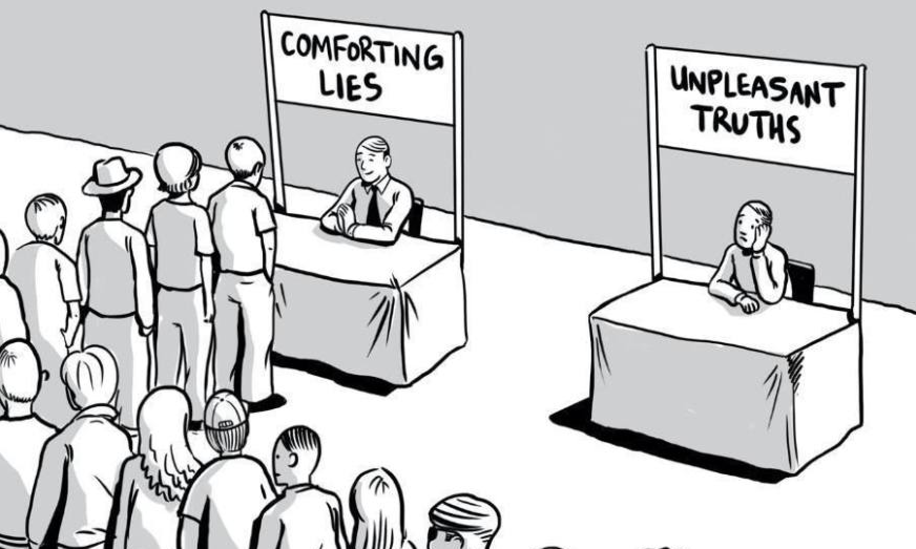

Kendimize sorabileceğimiz en büyük soru nedir?
Delmore effect
The more important something was, the less willing people are to spell out their goals or aims. Avoiding defining what constitutes success or failure.
Willful Blindness
We rather not know the answers. Because that's a spotlight on us. We rather tell stories (lies) to ourselves.
Going Against The Most Powerful Distraction Systems In The World
If not used right, social media is the biggest time consumer ever made.
Fearing the Right Thing
What path I am on? Fear of failure vs fear of mediocrity?

Slide 3
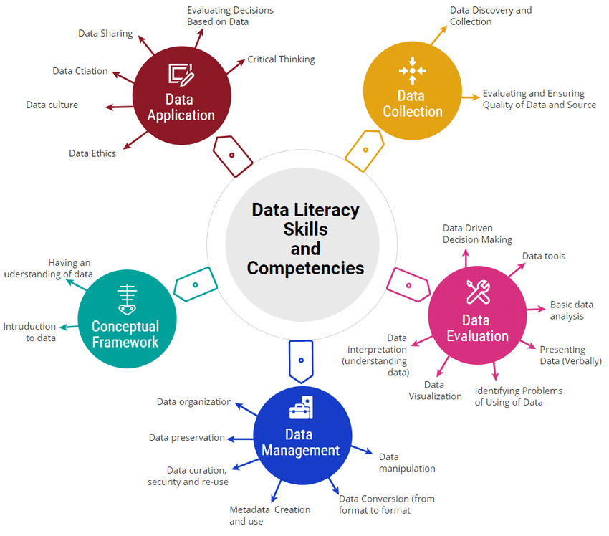
Veri Mühendisliği
Data literacy is the ability to read, understand, generate, and communicate data as information.
Research Gate

Slide 4
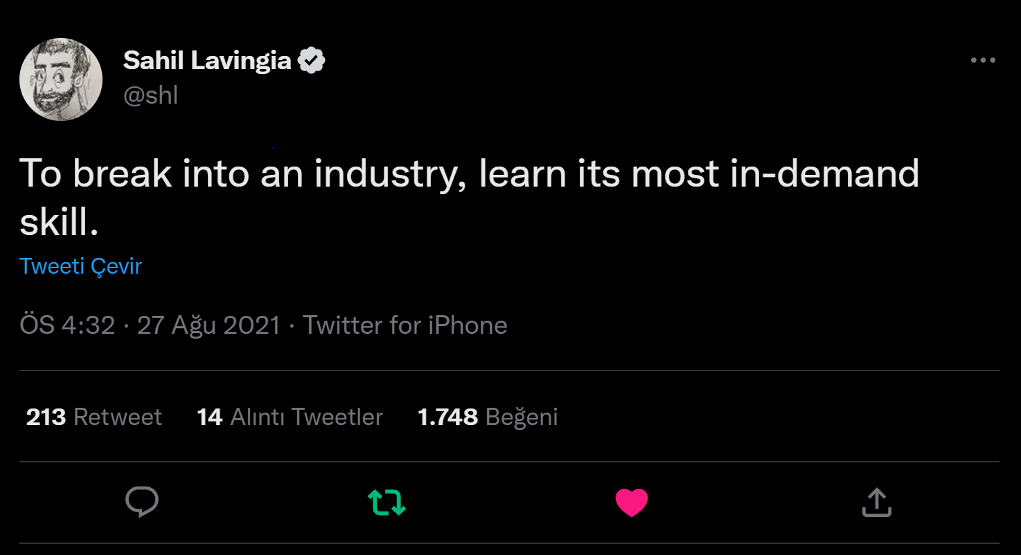
Bad news: No one cares what you can do.
Good news: Everyone cares what you can do for them.

Slide 5
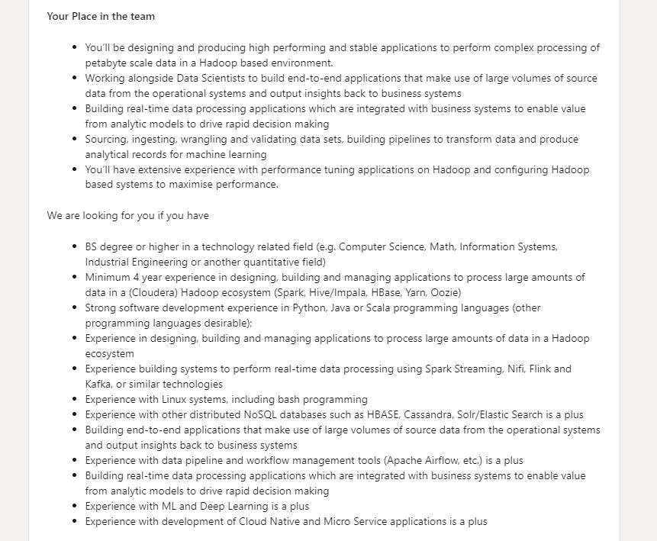
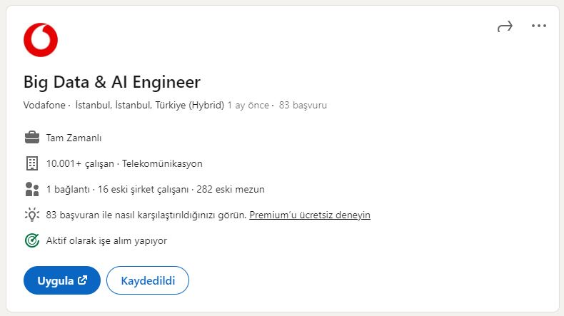



Linkedin

Slide 6
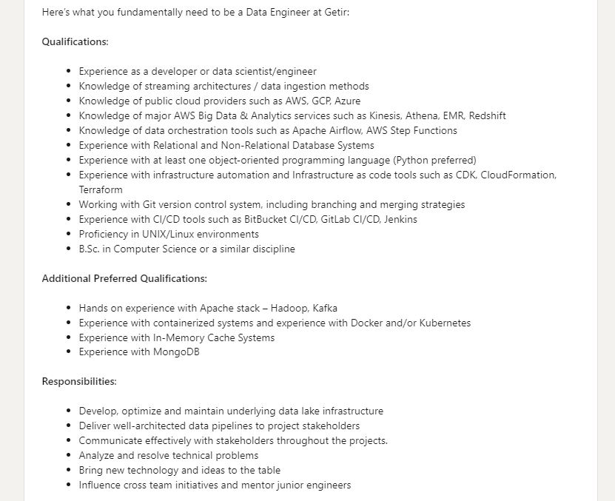
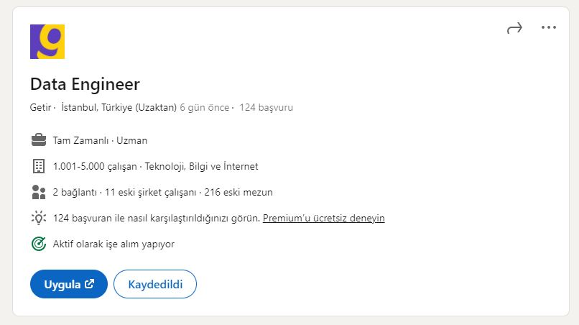


Linkedin

Slide 7
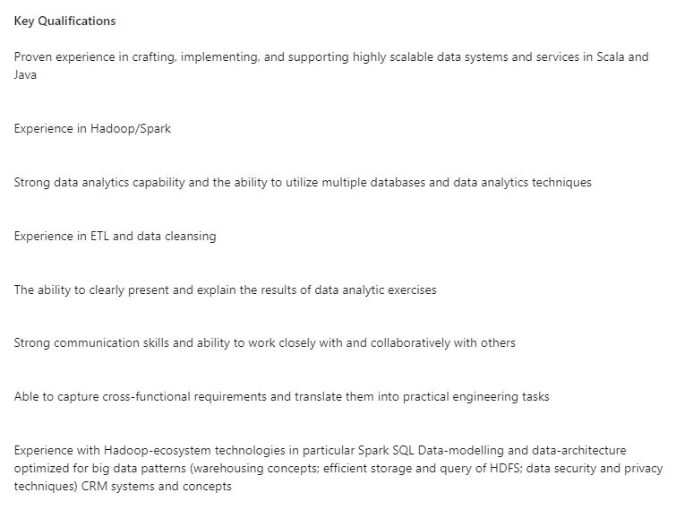
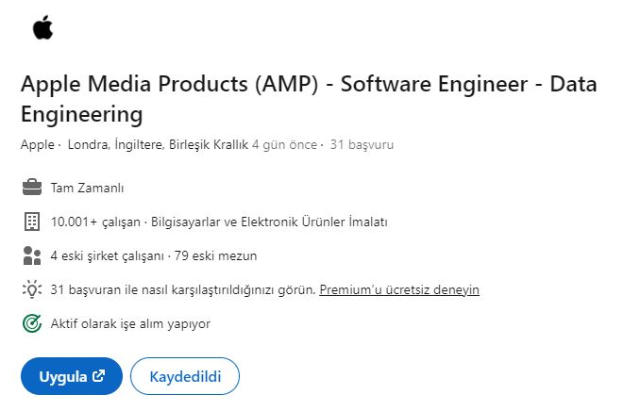


Linkedin

Slide 8
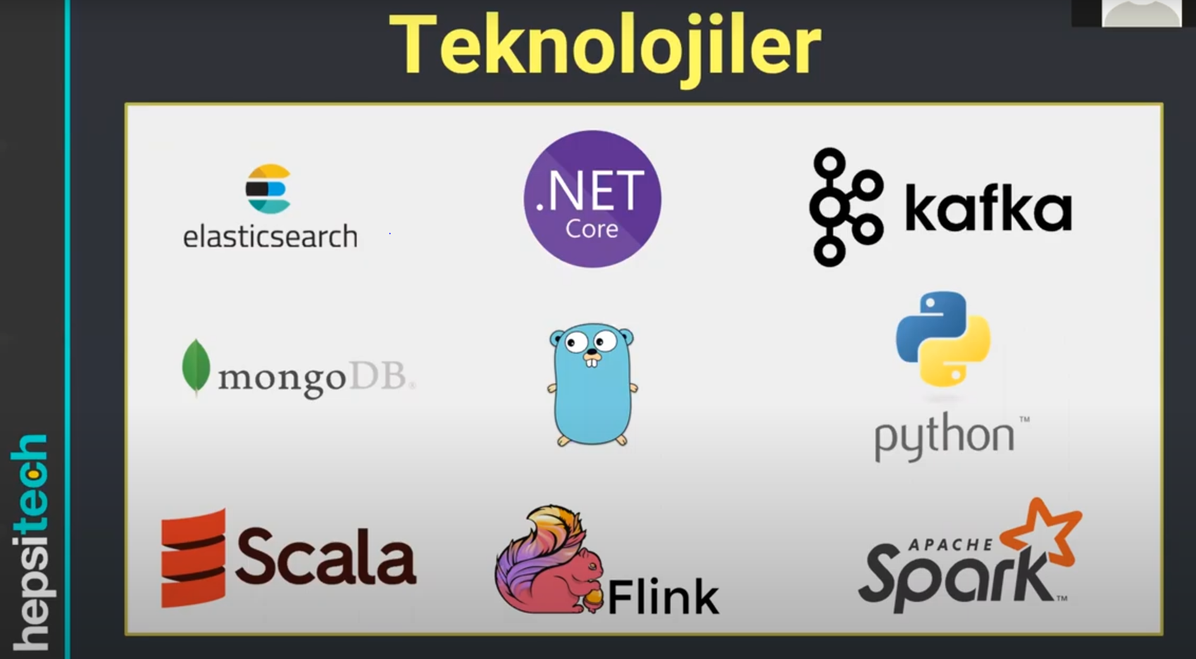

Youtube
Youtube
HepsiBurada
Ürünlere ait tüm veri. Satıcılar, stok, fiyat değişimi.

Slide 9
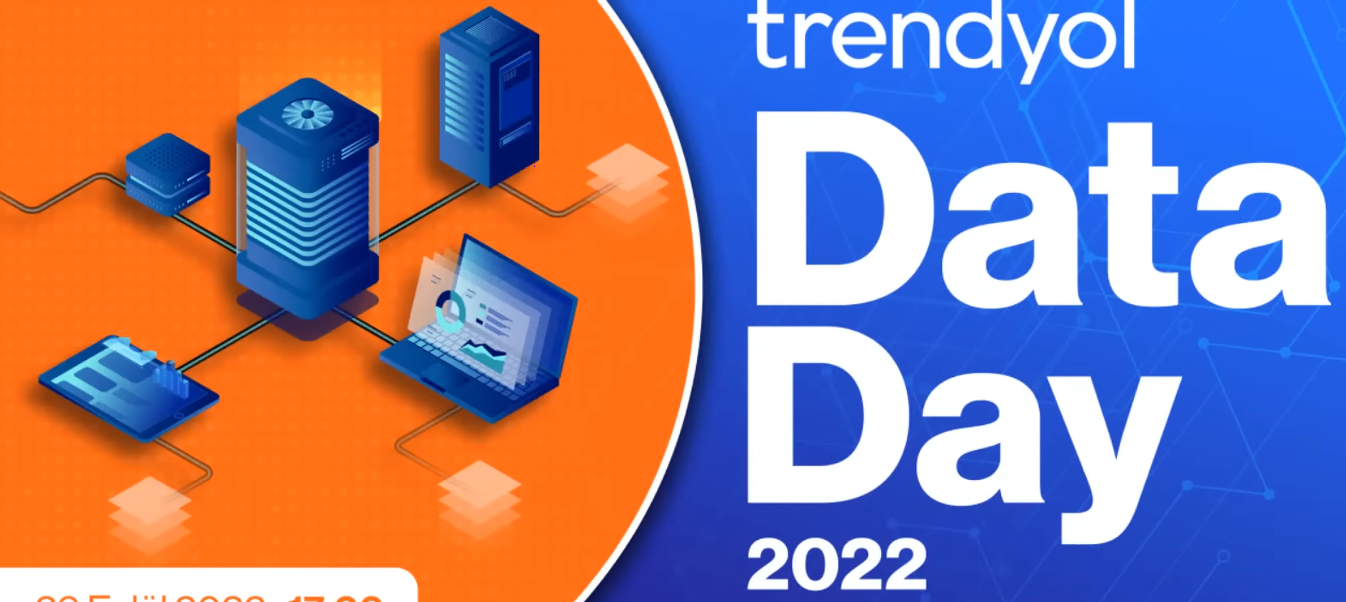


Youtube
Trendyol’da Yaptığınız Her Şey - Pageview - Search - Favorite
Clickstream Platform (58:00) - “Delphoi”

Slide 10
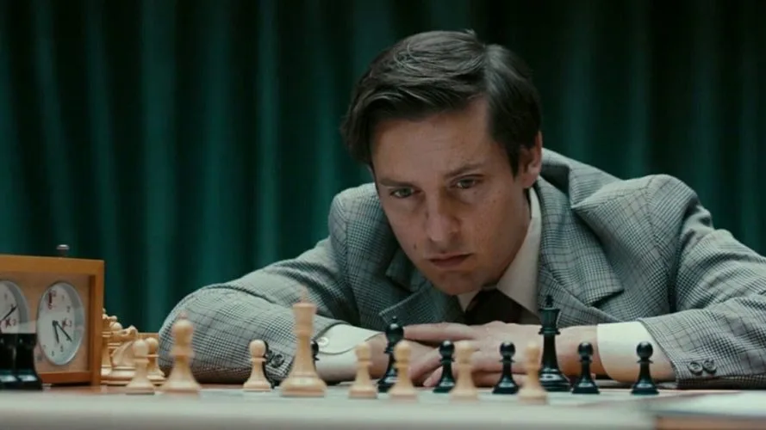

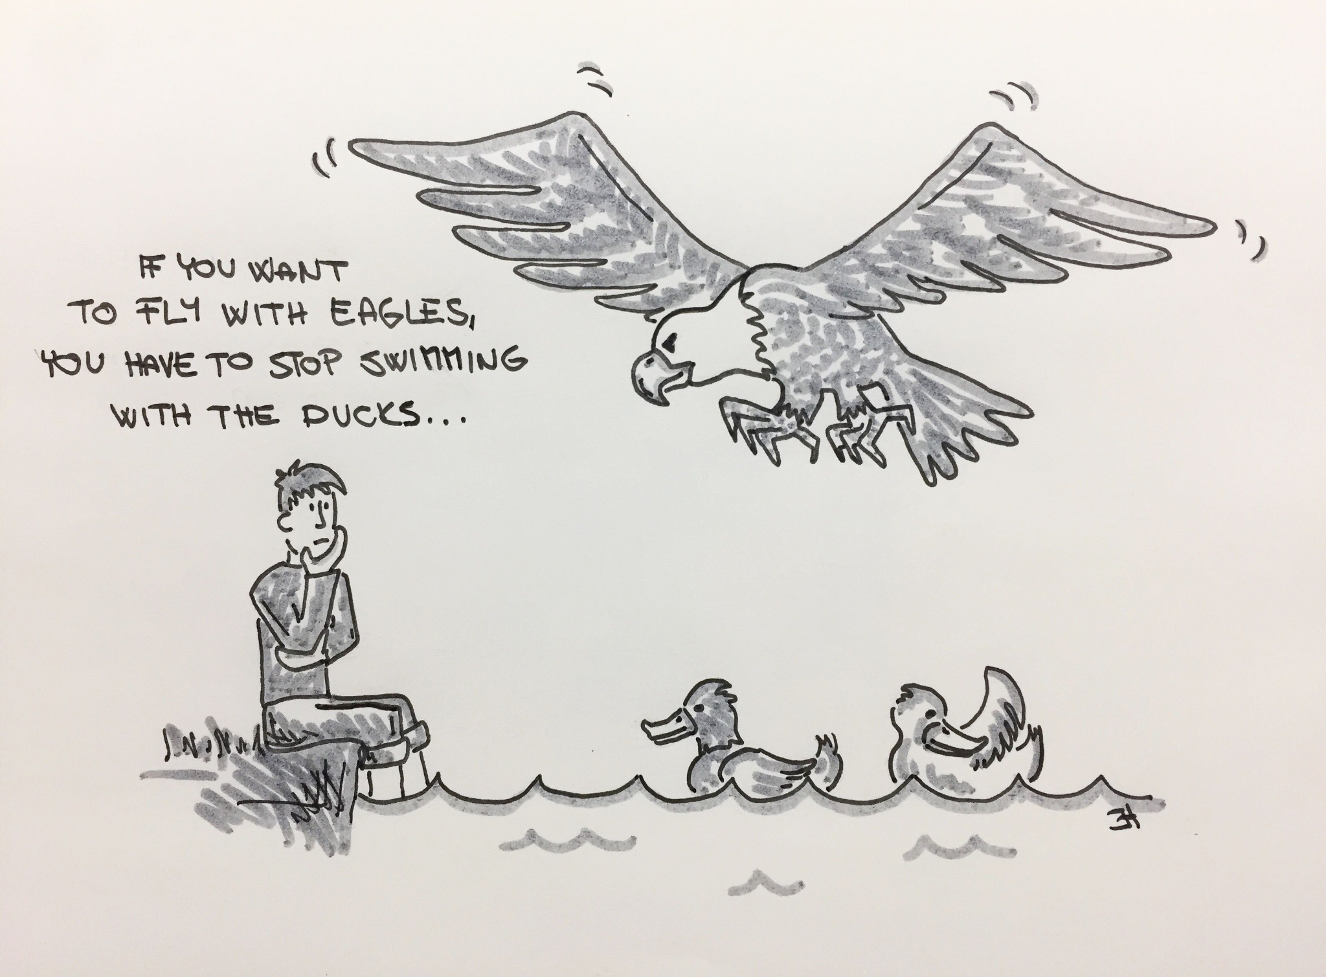
What is the best move on the chessboard?
You are the average of 5 people you most spent time with. So don’t just abandon them, but analyze yourself in regular periods.
Self Awareness
People close to you, most of them are kind. Force them to tell you what your strengths and weaknesses are. Given that you are open to constructive criticism.
Twitter

Slide 11

You can update your software.
Indefinite times.

Slide 12
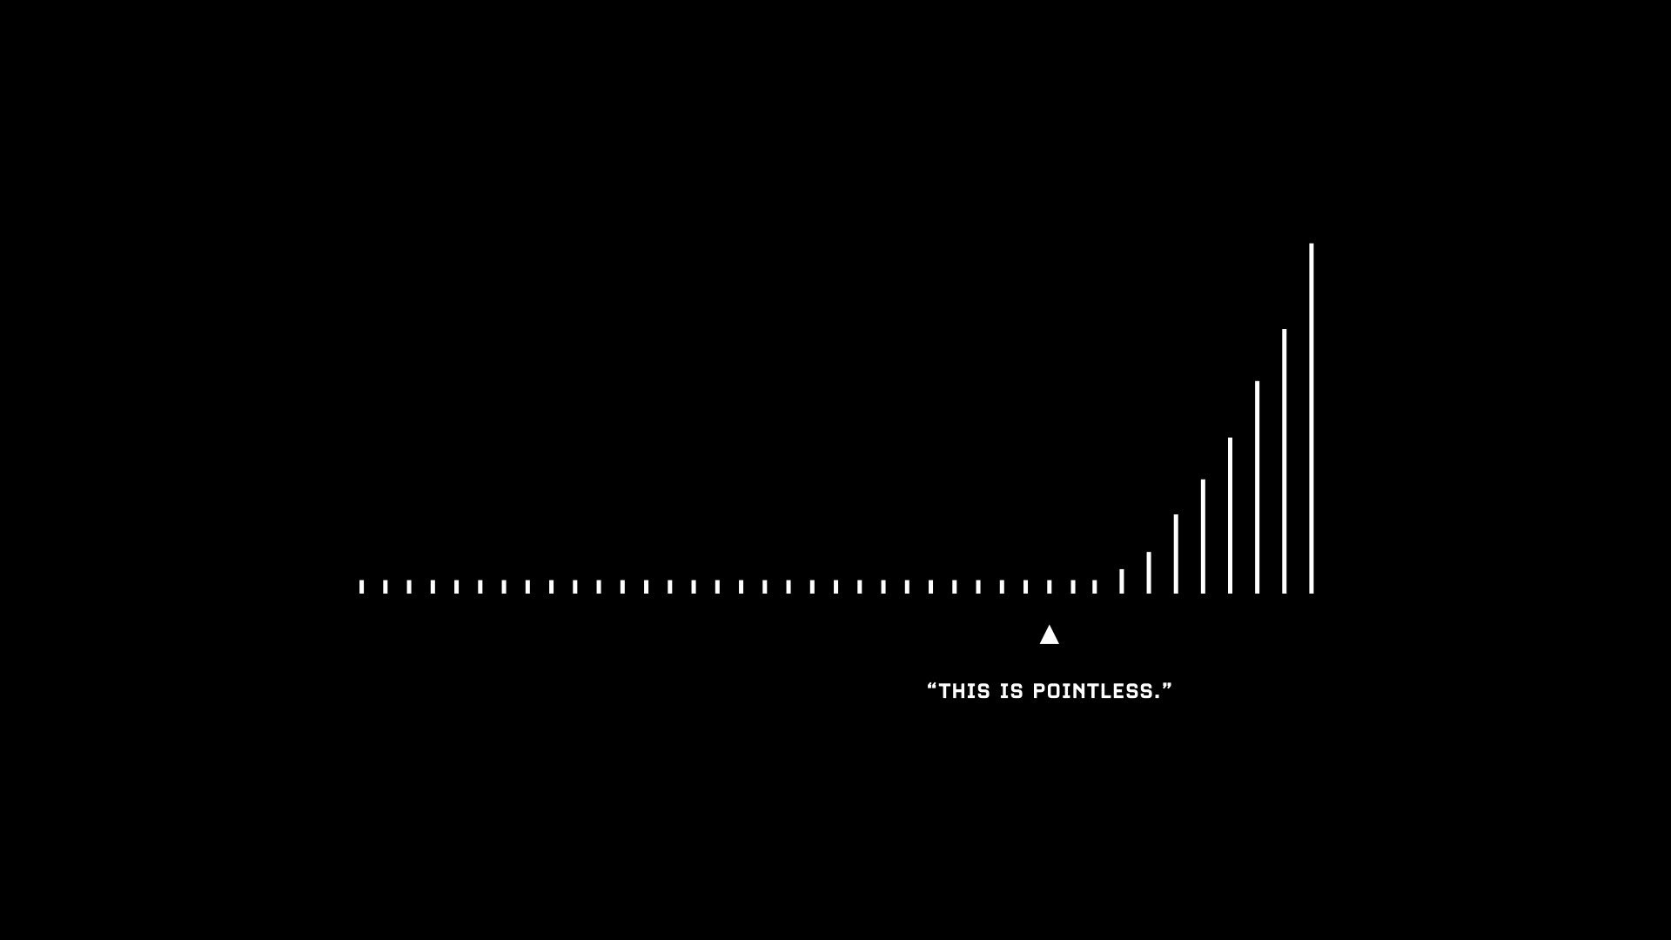
This is the normal.

Slide 13







sezaiburakkantarci@protonmail.com
@sezaiburakkantarci
@Victory_#2188
@sezaiburakkantarci
@kantarcise
@sezaiburakkantarci
@sezaikantarci
@sezaiburakkantarci

